Slide 1
Zhaodong Yang’s Resume
Education
Georgia Institute of Technology (2021-2023)
M.S. in Robotics
GPA:4.0/4.0
Courses: Computer Vision(4.0); Computer Graphics(4.0); Artificial Intelligence(4.0); Intro to Robotics Research(4.0);
Zhejiang University (2017-2021)
Bachelor of Engineering, Control Science and Engineering
Specialty: Robotics
GPA:3.84/4.0
WORK EXPERIENCE:
Graduate Teaching Assistant in Georgia Tech
Intro to Perception and Robotics (Summer 2022), Artificial Intelligence (Fall 2022), which includes content of search, Game AI, Bayesian Network, deep learning, and Robotics algorithm like RRT, and PoseSlam with ICP.
Course Projects Development: Develop and contribute to the course projects repository, auto-grader configuration.
Office Hours: Hold weekly office hours and answering questions online.
Notes:
I am also doing research for academic credit with Professor Frank Dellaert. My current project is investigating how detecting vertical lines in images can be used to improve the performance of 3D reconstruction algorithms

Slide 2





Computer Vision Projects
2020 Aug. – 2021 Jan.
Canny Edge Detection: Using OpenCV to implement Canny Edge Detection with C++. Writing pixelwise implementation of Sobel filter, Non-Maximum Suppression and Double Threshold.
Original Image after Gaussian filter
Gradient Magnitude after Sobel filter
Non-Maximum Suppression
Double Threshold
Can be used for Contrast Detection AutoFocus

Slide 3
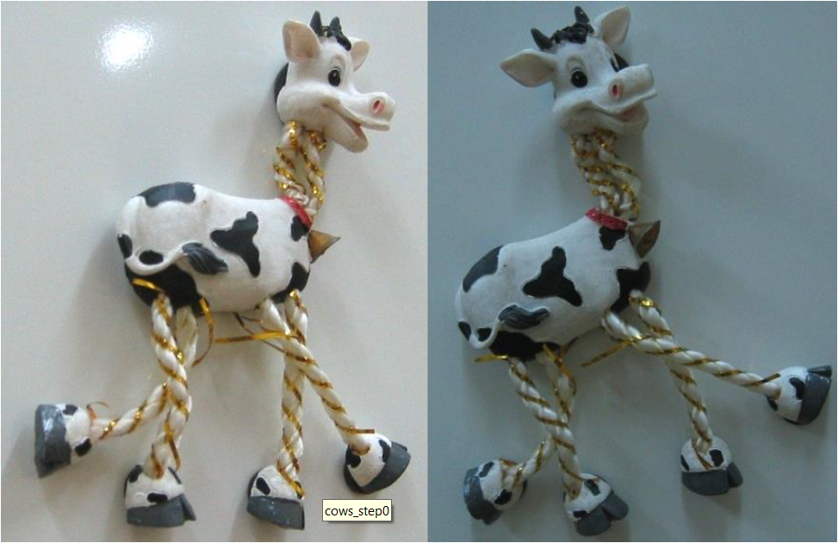
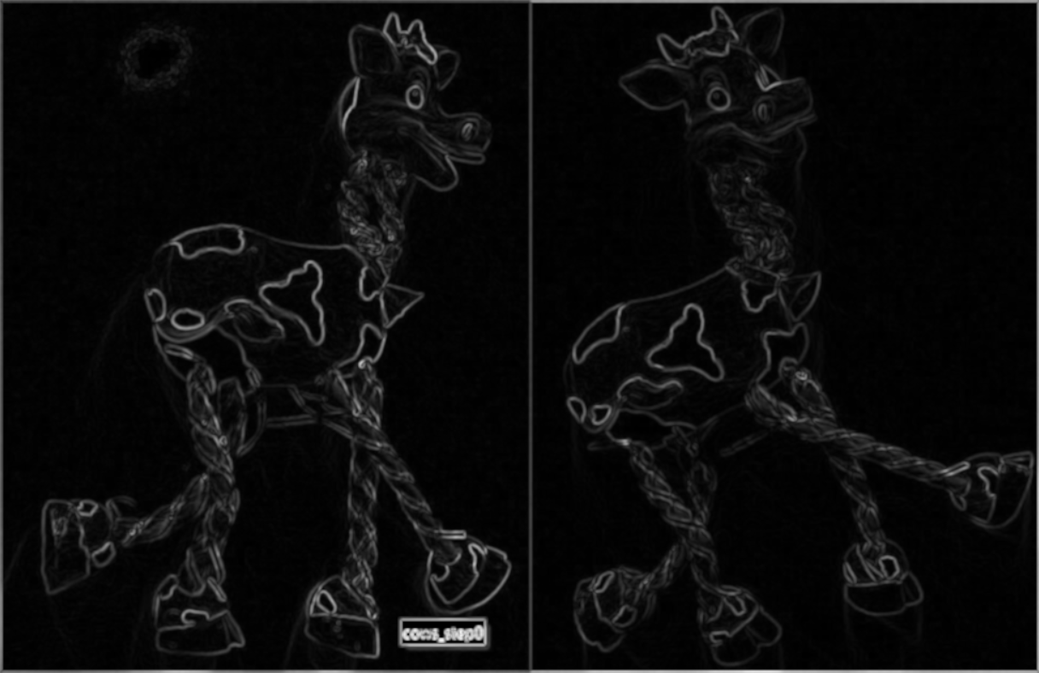
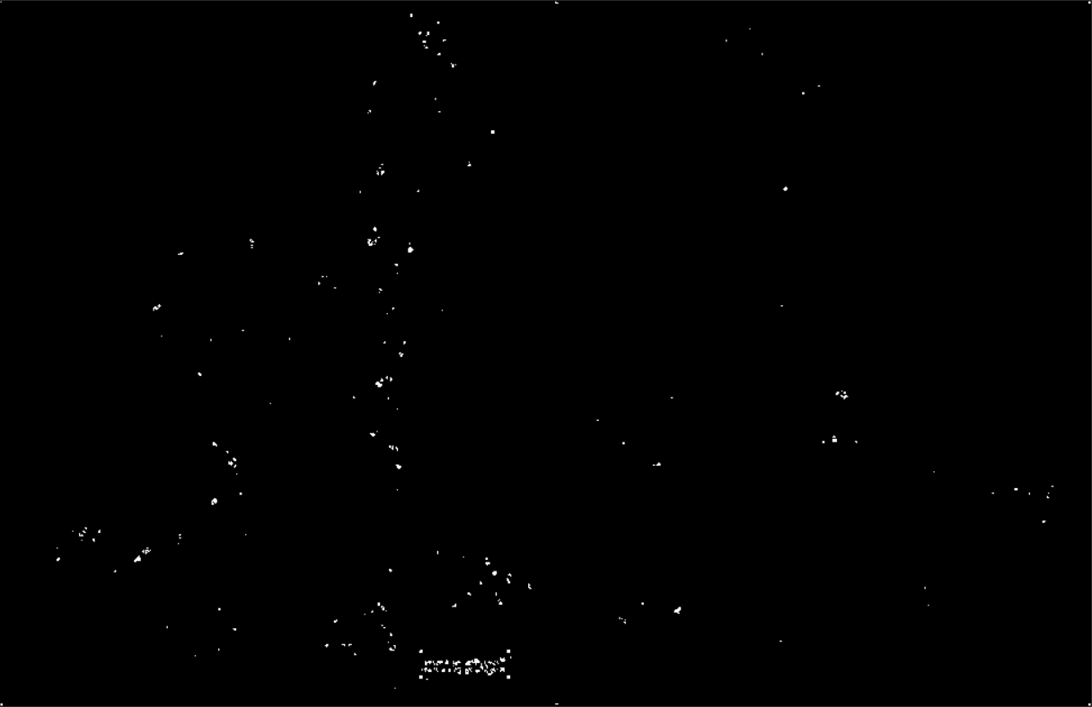
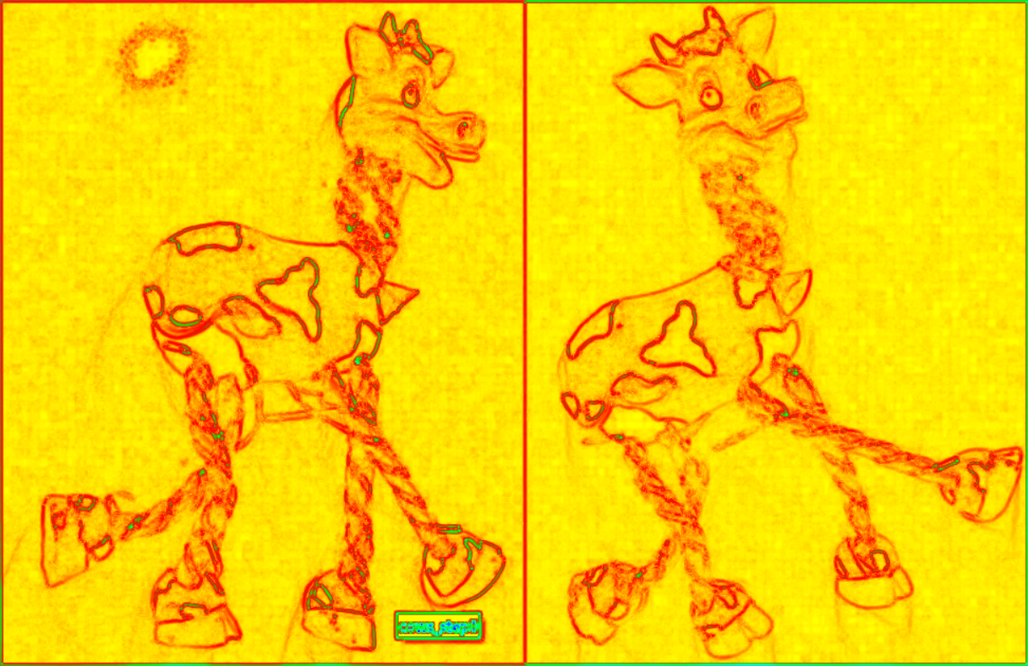
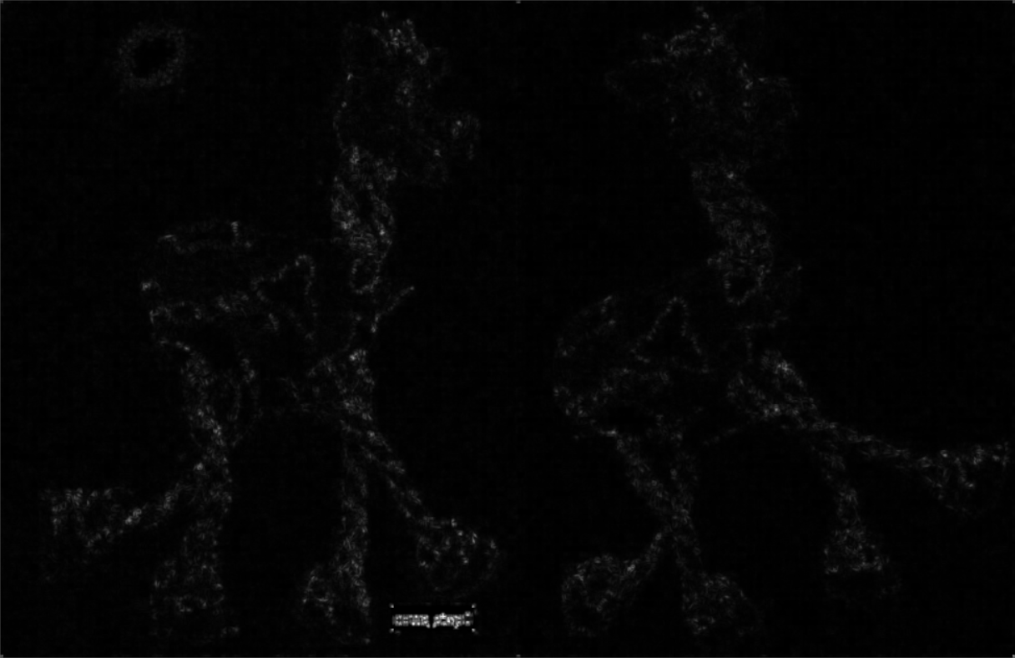
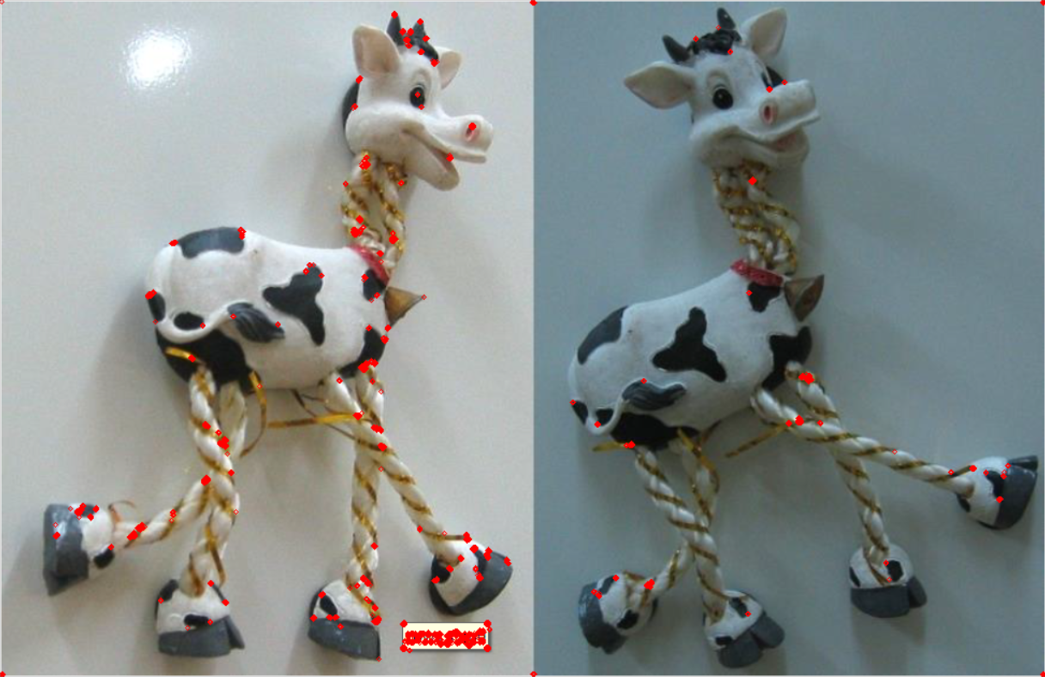
Computer Vision Projects
2020 Aug. – 2021 Jan.
Harris Corner Detection: Using OpenCV to implement Harris Corner Detection with C++. Writing pixelwise implementation of Corner Response, Non-Maximum Suppression.
Original Image and Corner Response R image
Edges and corners in the image
Non-Maximum Suppression and Result of Corner Detection

Slide 4
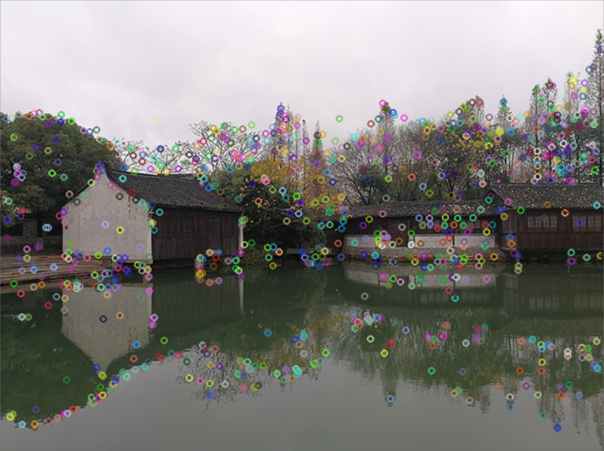
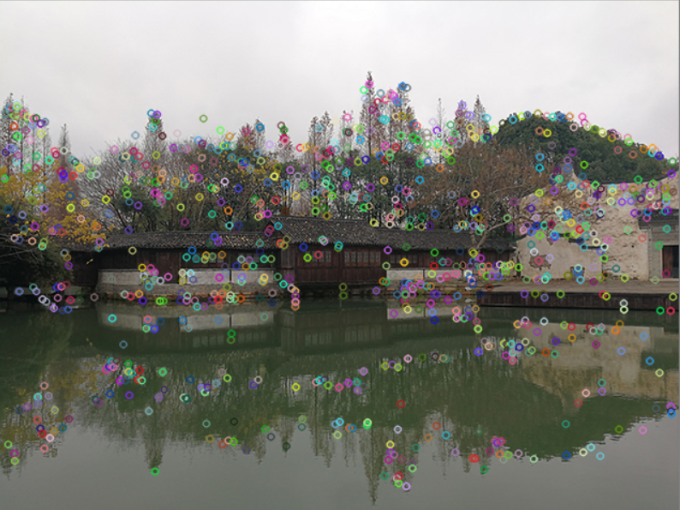
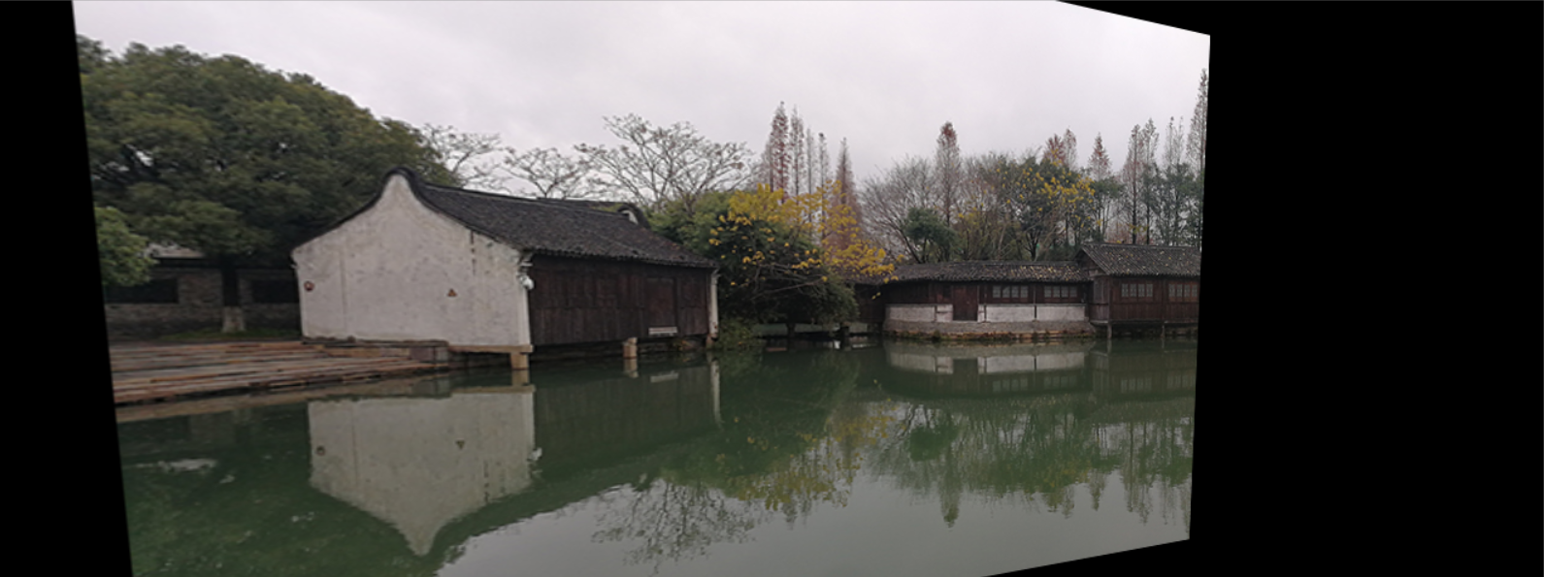
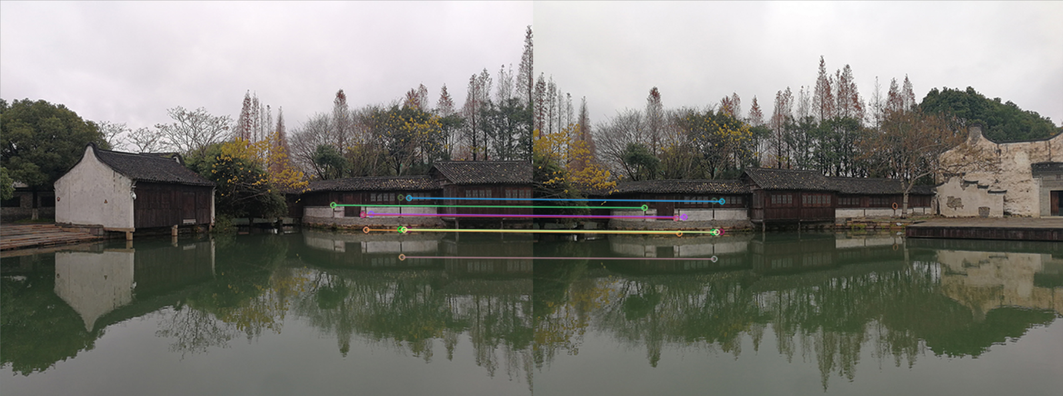
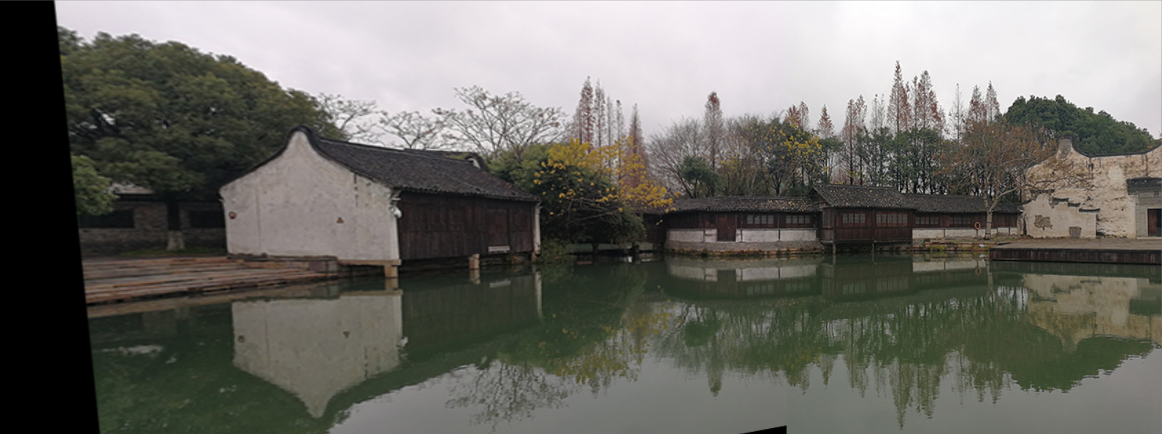
Computer Vision Projects
2020 Aug. – 2021 Jan.
Image Stitching: Using OpenCV to implement Image Stitching with C++. Using Feature Detector of OpenCV, Feature Descriptor, and Matcher to detect and match the key-points. Then calculate homography transform according to the key-point correspondence.
Key Point Detection of two images
Calculate Affine Transformation
Match Key Point
Stitch two images
Can be used for taking panoramas

Slide 5
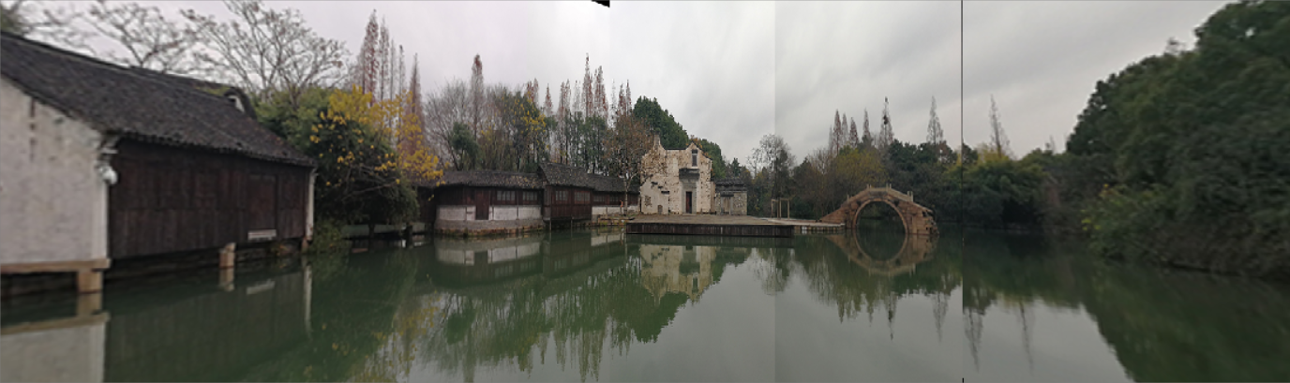
Computer Vision Projects
2020 Aug. – 2021 Jan.
Image Stitching: Using OpenCV to implement Image Stitching with C++. Using Feature Detector of OpenCV, Feature Descriptor, and Matcher to detect and match the key-points. Then calculate homography transform according to the key-point correspondence.
Final Result
Can be used for taking panoramas

Slide 6
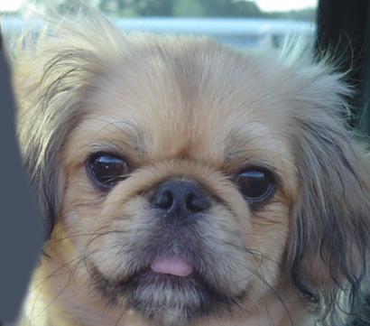

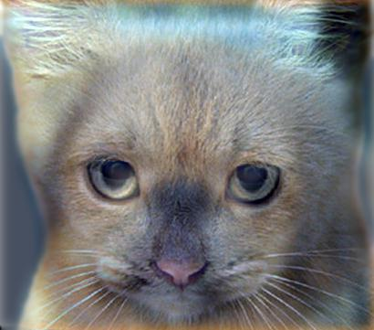

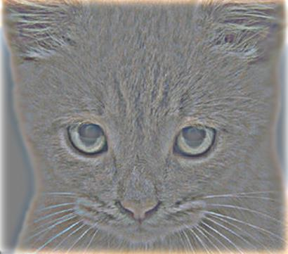
Computer Vision Projects
2021 Aug. – 2021 Dec.
Hybrid Image: Used low pass Gaussian filter to hybrid two images.
Image after Low Pass Gaussian Filter
Image after High Pass Filter
Hybrid Image

Slide 7
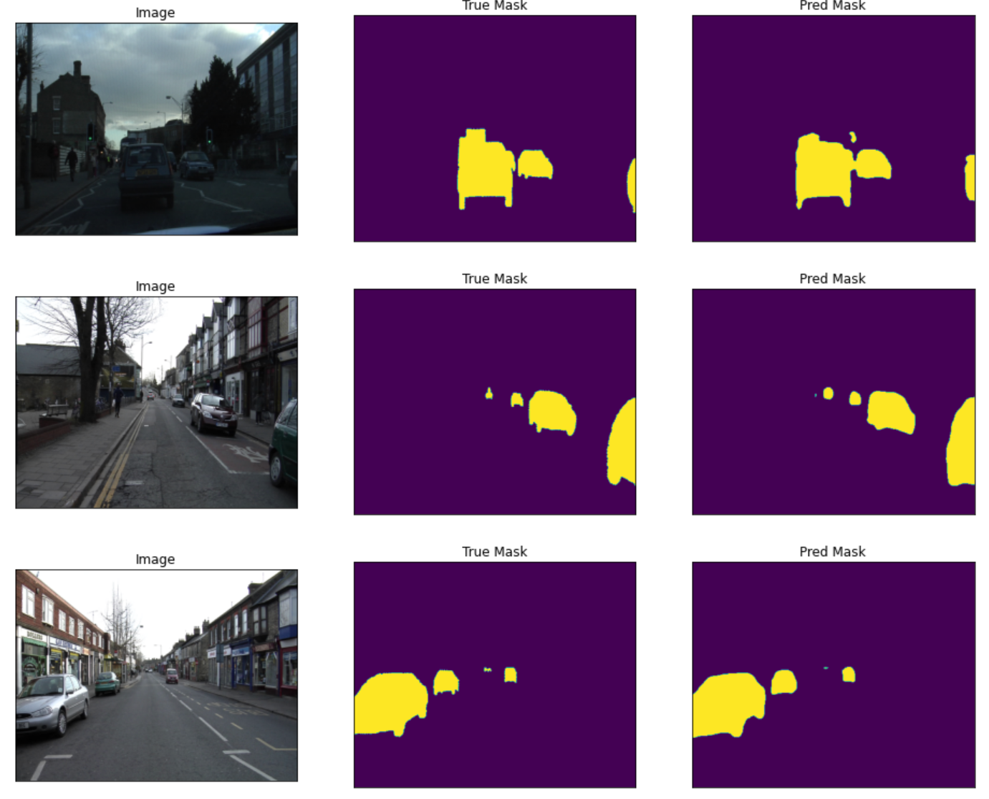
Computer Vision Projects
2021 Aug. – 2021 Dec.
Segmentation by Fully Convolutional Networks : Used segmentation_models_pytorch to segment image with Feature Pyramid Network, with different backbones, VGG-19 and ResNet-50

Slide 8
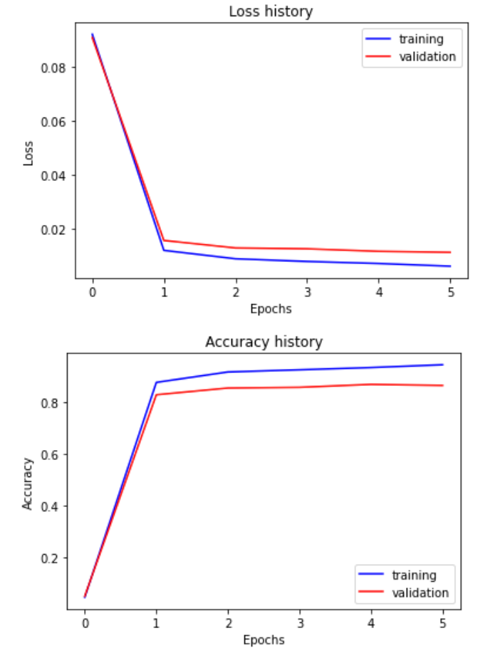
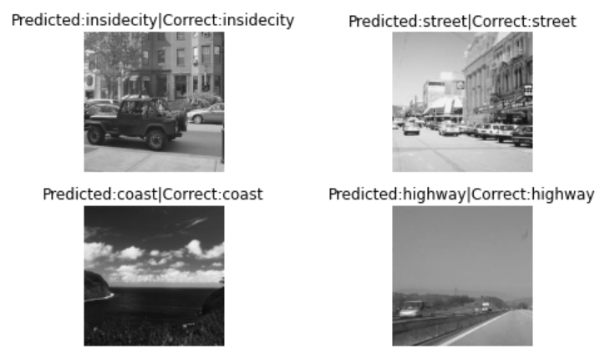
Computer Vision Projects
2021 Aug. – 2021 Dec.
CNN: Used PyTorch to make a CNN model, Loss function and optimizer. Trained part of AlexNet for image recognition.
Training AlexNet for Recognition
Loss history and Accuracy history of training AlexNet

Slide 9
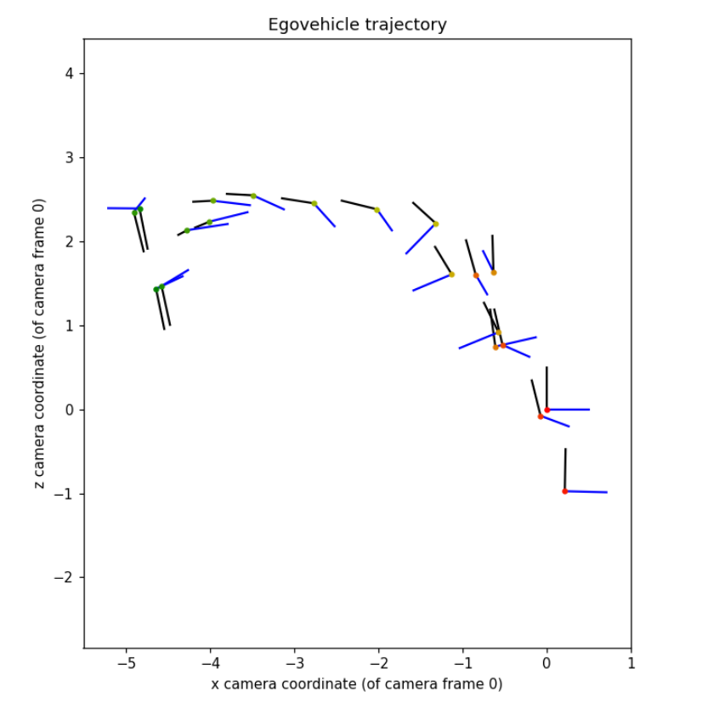
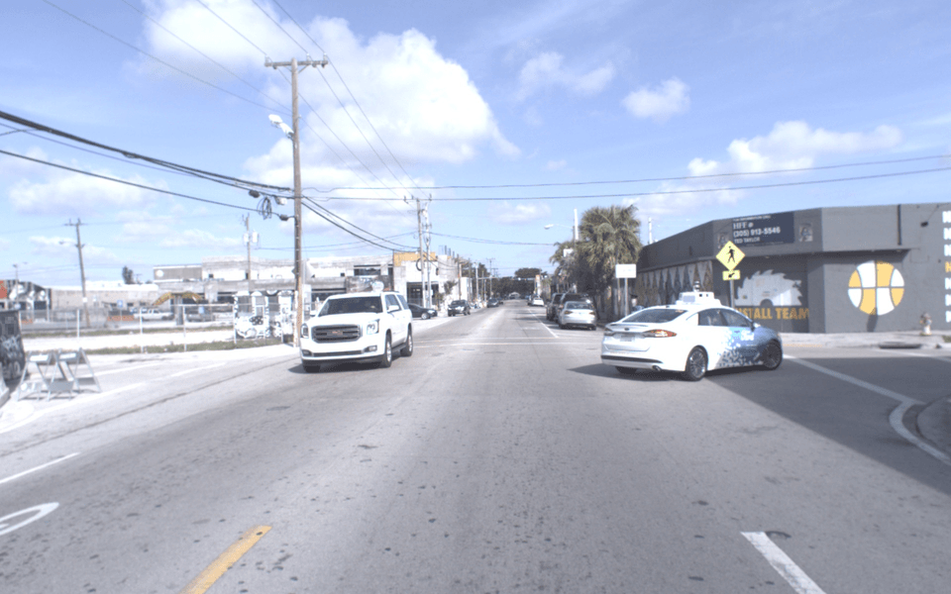
Computer Vision Projects
2021 Aug. – 2021 Dec.
Visual Odometry: Used Numpy to calculate the projection matrix from 3D to 2D, Fundamental Matrix, and Visual Odometry.
Visual Data Series
Calculated Camera Poses
Visual Odometry:

Slide 10
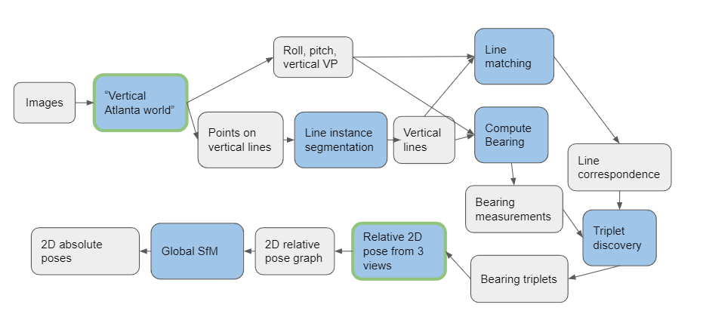

GTSFM 3D Reconstruction
2021 Dec. – Now
GTSFM is an End-to-end SFM framework, developed by Prof. Frank Dellaert and his students
Vertical Line Detection: Detect vertical lines in an image using EM and Bayesian Inference
2D Localization and Mapping: Implement a linear algorithm which could recover 2D robot poses and landmark positions with bearing-only measurements
Currently working on line instance segmentation and line correspondence
Utilize vertical lines in man-made environment
Algorithm Pipeline

Slide 11
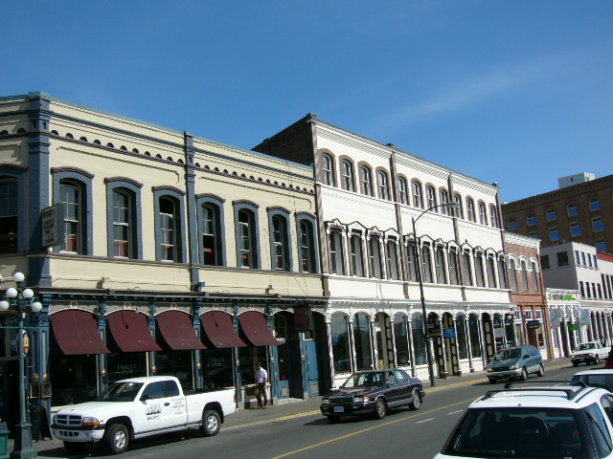
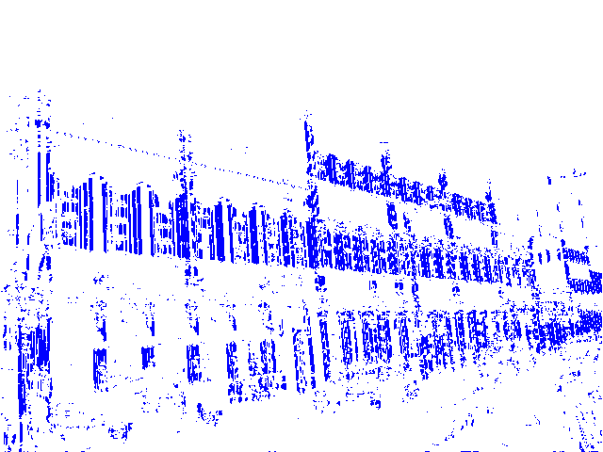
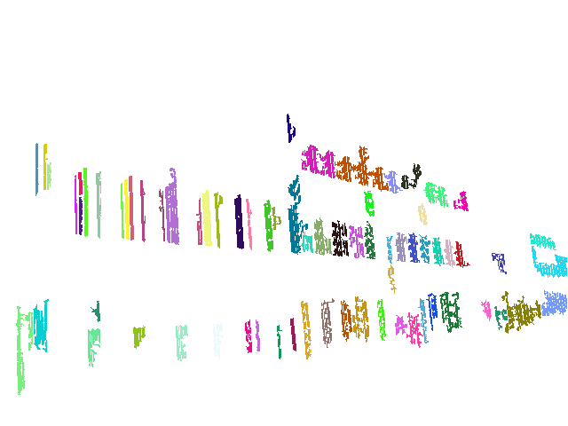

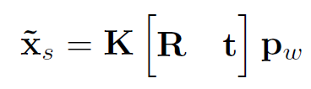
GTSFM 3D Reconstruction
2021 Dec. – Now
Vertical Line Detection: Detect vertical lines in an image using EM and Bayesian Inference. Based on “Atlanta World” by Frank Dellaert and Grant Schindler
Vanishing Point
Angle between gradient orientation and the line connecting pixel and vanishing point
Pixel
Pixel Gradient Orientation
The bigger the gradient magnitude is, the pixel is more likely to be on a line
The smaller the angle is, the pixel is more likely to be on a vertical line
How do we get vanishing point of vertical lines?
By estimation of Camera Extrinsic and Intrinsic parameters
Detect pixels that belong to a vertical line

Slide 12
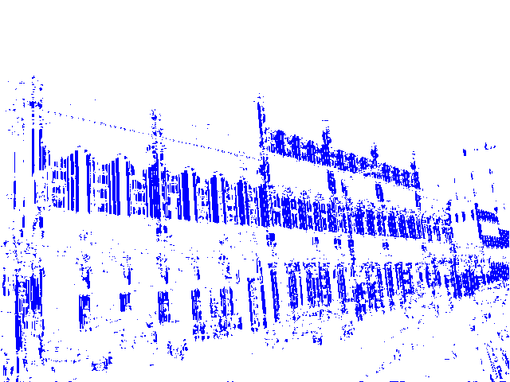
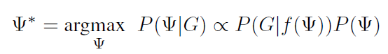
GTSFM 3D Reconstruction
2021 Dec. – Now
Vertical Line Detection: Detect vertical lines in an image using EM and Bayesian Inference. Based on “Atlanta World” by Frank Dellaert and Grant Schindler
Initialize Camera Extrinsic (rotation Euler angles)
Calculate vertical vanishing point
Maximize the posterior of the camera extrinsic parameters in condition of the image gradient
Use the camera extrinsic parameter to calculate the likelihood of each pixel belongs to a vertical line/a random line/no line
Detect pixels that belong to a vertical line

Slide 13
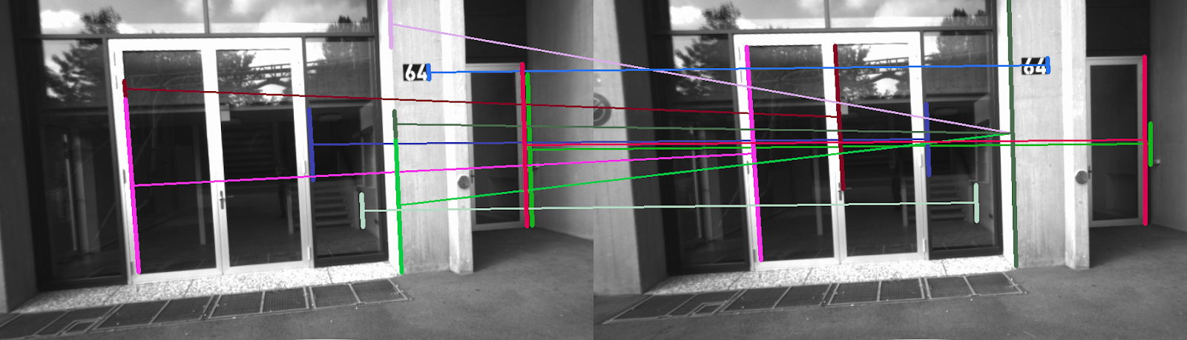
GTSFM 3D Reconstruction
2021 Dec. – Now
Line Band Descriptor of vertical line LBD
Appearance Similarity matching

Slide 14
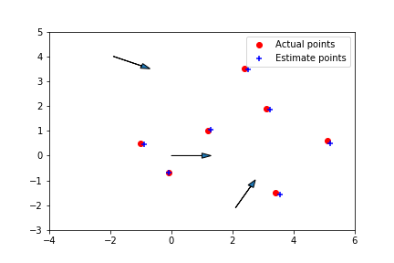
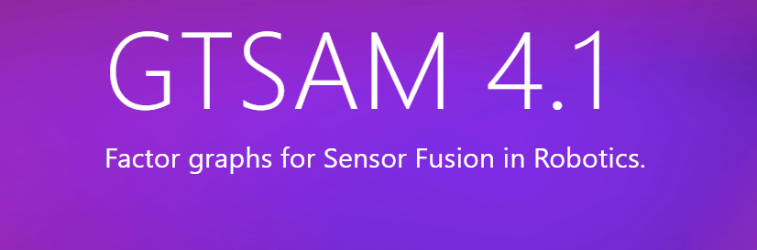
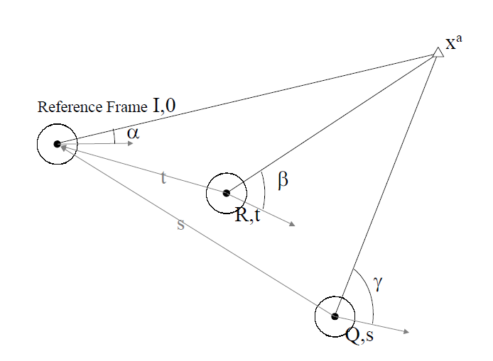
GTSFM 3D Reconstruction
2021 Dec. – Now
2D Localization and Mapping:
Add a new class “Trifocal_Tensor_1D” to the C++ Sensor Fusion Library GTSAM
Arrow is camera, red dot is landmark, ‘+” is the estimated landmark position

Slide 15
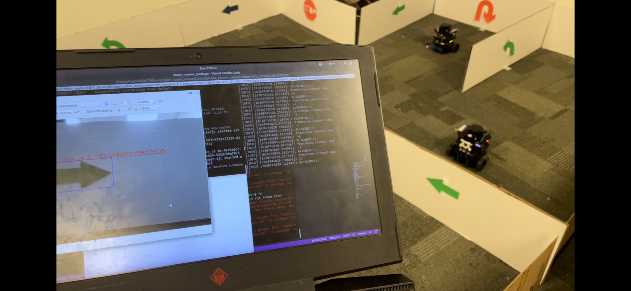
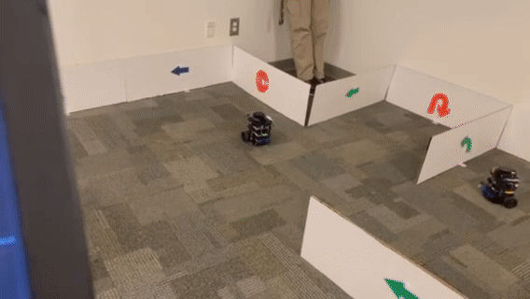
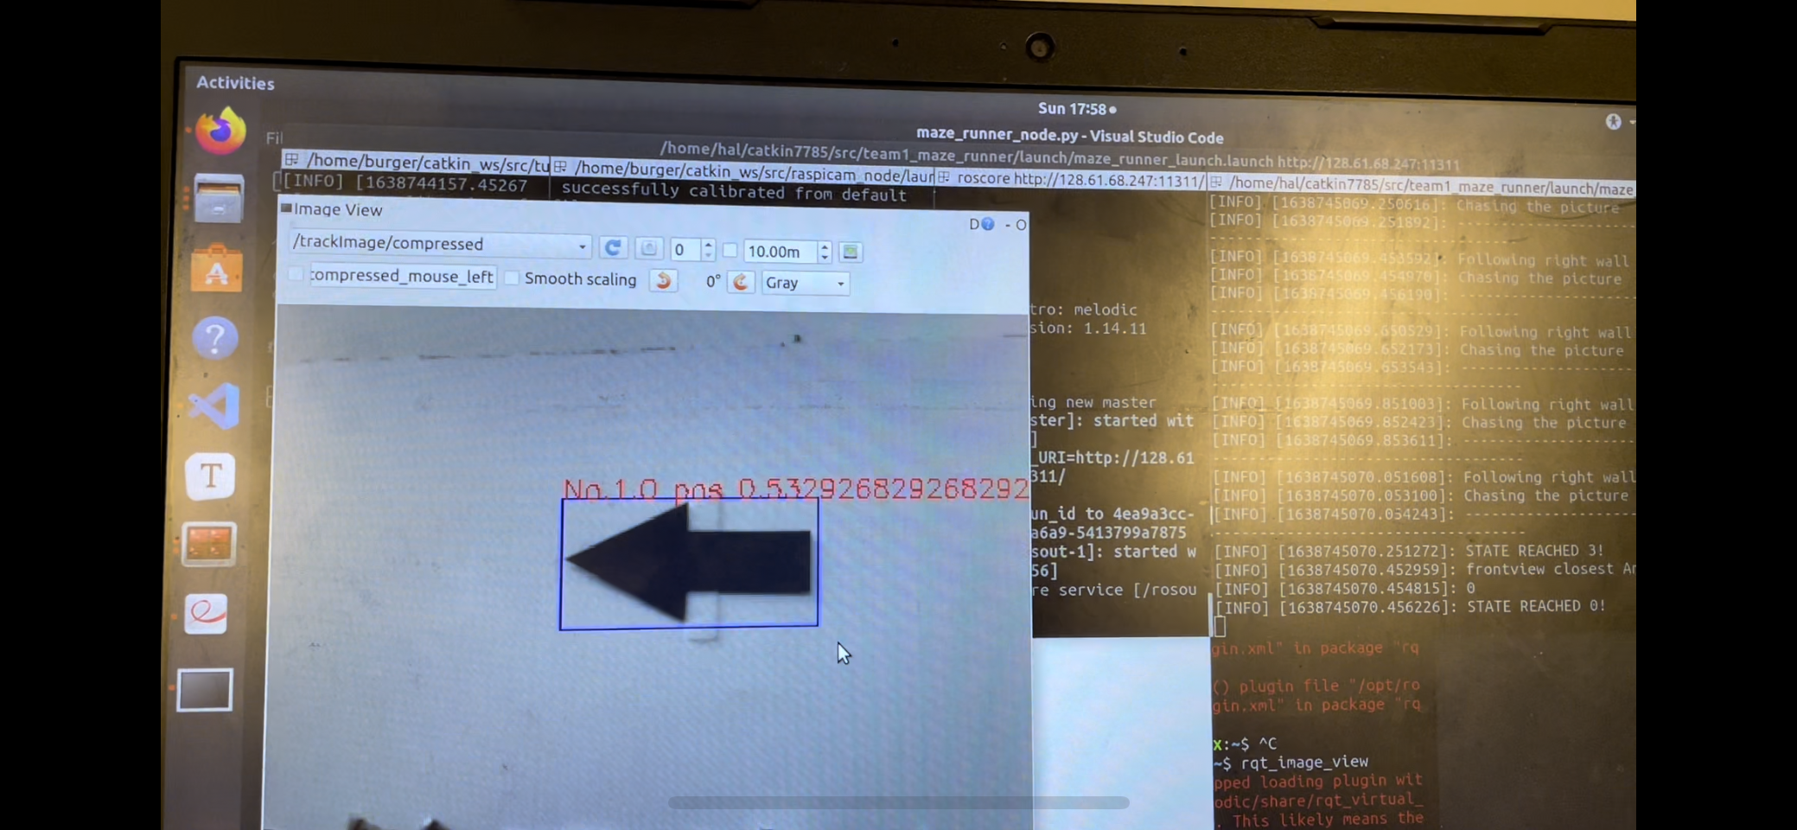
Ros Projects on Turtlebot
2021 Aug. – 2021 Dec.
Robot Maze Solving: Including image recognition using KNN and K-Means, laser lidar localization, and robot motion control
Robot in the maze
Image data sent to a computer by the robot, where the image is recoginized

Slide 16
Image Processing Projects
2019 Aug. – 2020 Jan.
Image Recovery: Used Matlab function of Wiener Filter to recover an image.
Image that has a Gaussian Noise of length 30 and rotation angle 11 degree
Image after Wiener Filtering
Image after Average Filtering

